Slide 1
Machine Learning System Design
Andrei Paleyes
AI4ER, November 2023

Slide 2
About you!
Raise your hands if you ever:
trained a ML model?
fixed an issue in a model?
gave the model you worked on to anyone else?
created an app/website/service around a model?
updated an existing model with a new dataset?

Slide 3
What is machine learning?
?

Slide 4
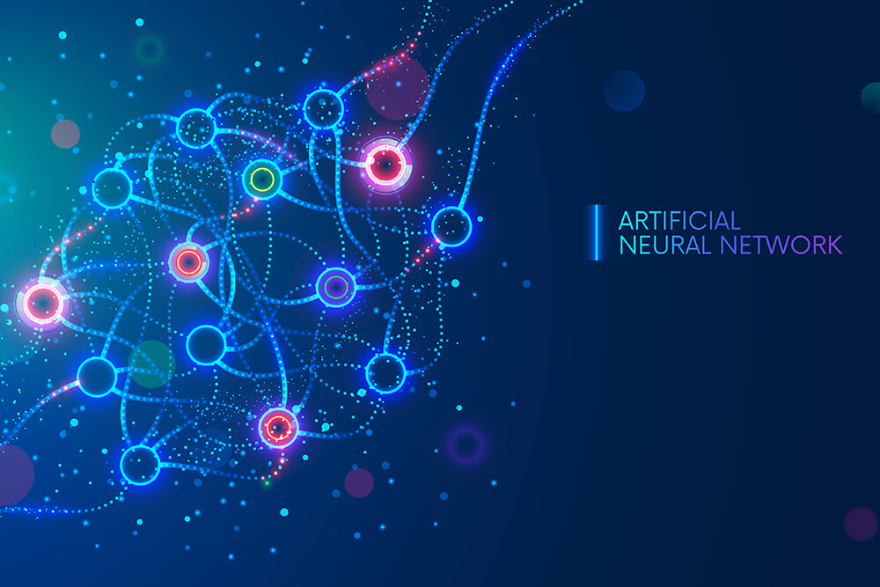
What is machine learning?
Machine learning (ML) is a field of inquiry devoted to understanding and building methods that 'learn', that is,
methods that leverage data to improve performance on some set of tasks.
Sources: Wikipedia (text) and Bernard Marr (image)

Slide 5

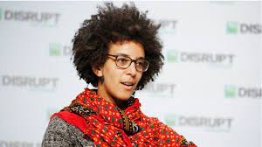
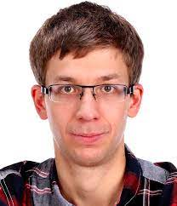

What is machine learning?
?

Slide 6
What is machine learning?
Model + Data = Machine Learning

Slide 7



Slide 8
What is machine learning?
Model + Data + System = Deployed Machine Learning

Slide 9
How to deploy ML systems

Slide 10
Step 1 – ask a question
?

Slide 11
First question you need to ask is …
“Do I really need ML?”

Slide 12
First question you need to ask is …
“Do I really need ML?”
because maybe you don’t

Slide 13

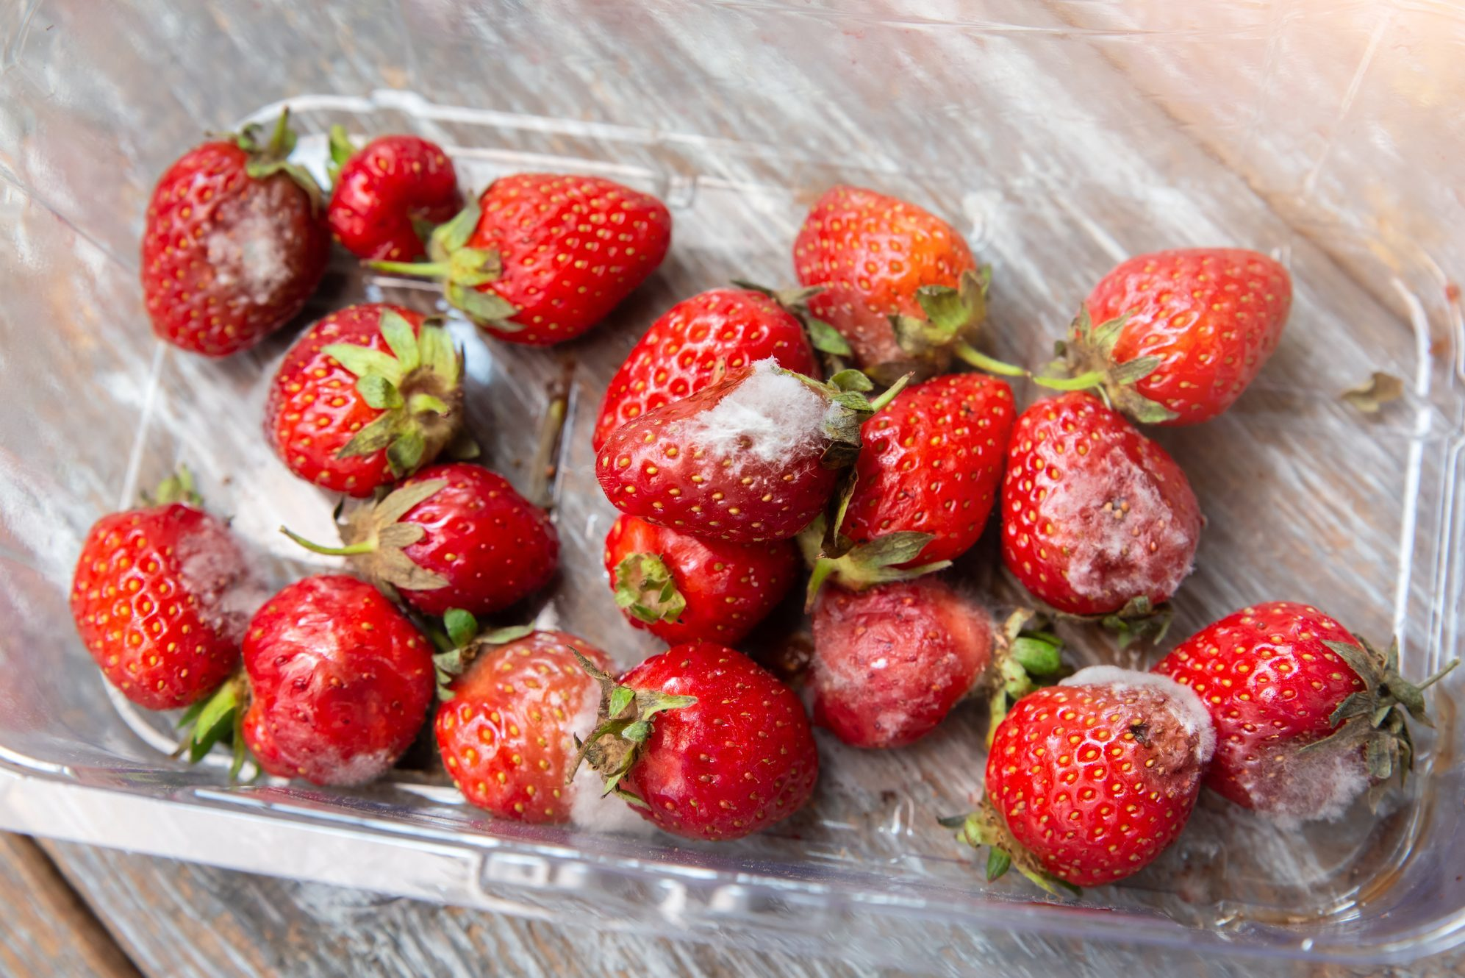
Example 1: Amazon vs Strawberries

Slide 14

Example 1: Amazon vs Strawberries

Slide 15
“If you think that machine learning will give you a 100% boost, then a heuristic will get you 50% of the way there.”
Martin Zinkevich, Google

Slide 16
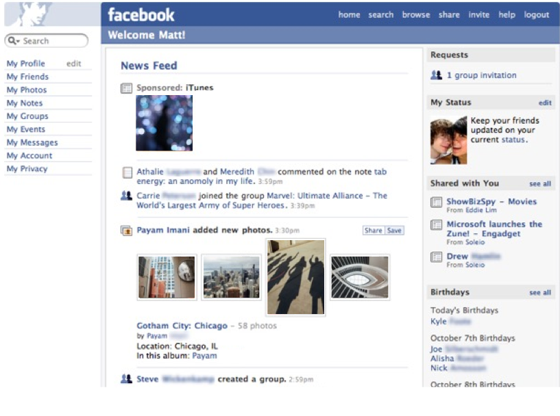
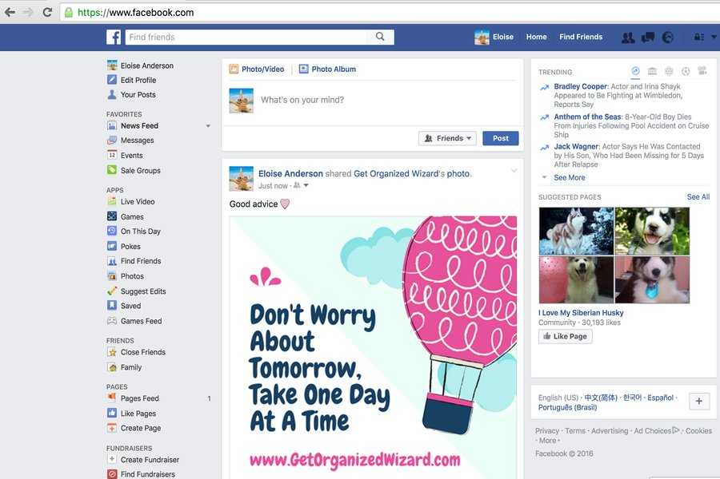
Example 2: Facebook newsfeed
?
2006
2022

Slide 17
Take home point
The best way to design an ML system often is not to design one.

Slide 18
Step 2 – how to measure success
?

Slide 19
Ask this early!
No, seriously
Ask this question early!

Slide 20
Ask this early!
No, seriously
Ask this question early!
Remember the goal
Don’t overfocus on ML

Slide 21
“An interesting finding is that increasing the performance of a model does not necessarily translate into a gain in [business] value.”
150 successful machine learning models:
6 lessons learned at Booking.com
Bernadi et al., KDD’19

Slide 22
Other questions to consider
Who are my end users?
What are the biggest risks?
Is there data? Where and in what form?
Check out ML Canvas, https://www.ownml.co/machine-learning-canvas

Slide 23
Step 3 – Find the data

Slide 24
Find the data
?
Not a trivial problem!
Unlike in exercises or academic research

Slide 25
Why getting data is hard?
Data might be
Split between sources
Not saved
Different between training and inference
Unlabeled
Not clean

Slide 26
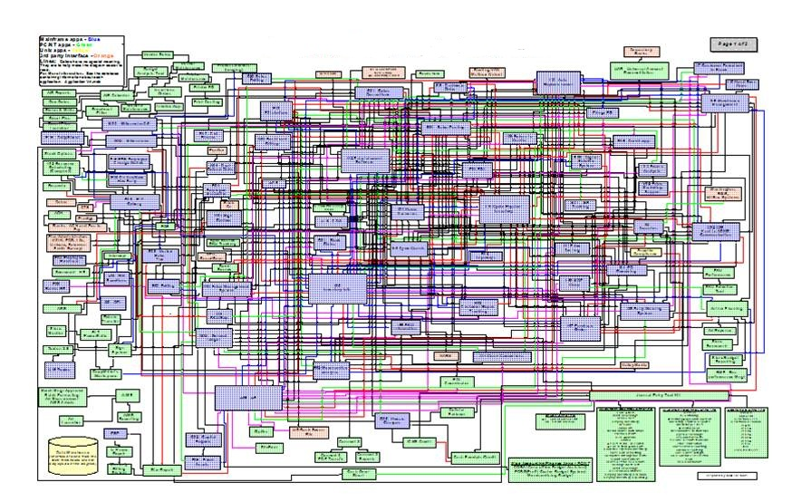
Example 1: Twitter
?
Can you find all user data here?
Scaling Big Data Mining Infrastructure — The Twitter Experience. Jimmy Lin and Dmitriy Ryaboy, 2013

Slide 27
Example 2: Atlanta Fire Department, project Firebird
?
12 datasets
History of incidents
Business licenses
Households
etc.
Join data on buildings by address
Took weeks!

Slide 28
Example 2: Atlanta Fire Department, project Firebird
?
Wolfson building, Madingley rise, Cambridge
Bullard Laboratory, CB3 0EZ, Cambridge, UK

Slide 29
Other questions to consider
What generates the data?
How to access it?
In which format is it?
Is it complete?

Slide 30
Step 4 – Store the data

Slide 31
Storage options
Memory
Text file(s)
CSV file(s)
JSON file(s)
SQL database
NoSQL database
Data stream

Slide 32
How do I choose?
?
Depends on your use case! Two main considerations:
Data modality
Purpose

Slide 33
Modalities
Tabular data
Time series
Images
Video
Free text

Slide 34
Purpose
To play with on your own
For fellow data scientists
For training
For batch processing
For online prediction

Slide 35
Other considerations
Structure (e.g. nested)
Size
Performance

Slide 36
Step 5 – train a model

Slide 37

Model training

Slide 38
Model selection
Complex model is not necessarily the best!
Why? Let’s ask spacecrafts!

Slide 39
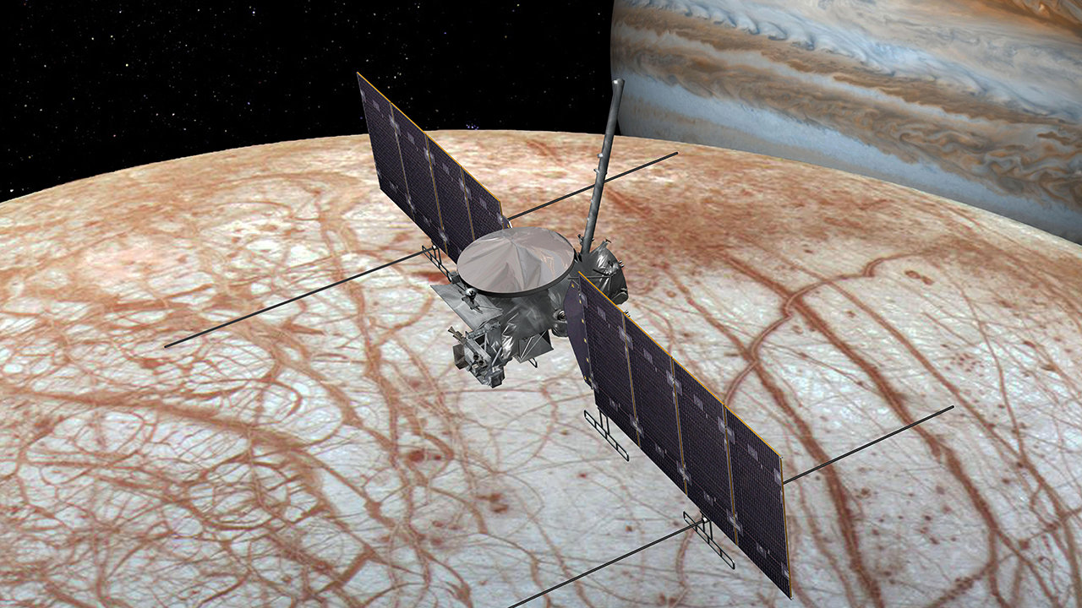
Example 1: Europa Clipper, 2024
PCA for anomaly detection!
Enabling onboard detection of events of scientific interest for the Europa Clipper spacecraft. Wagstaff et al, KDD 2019

Slide 40
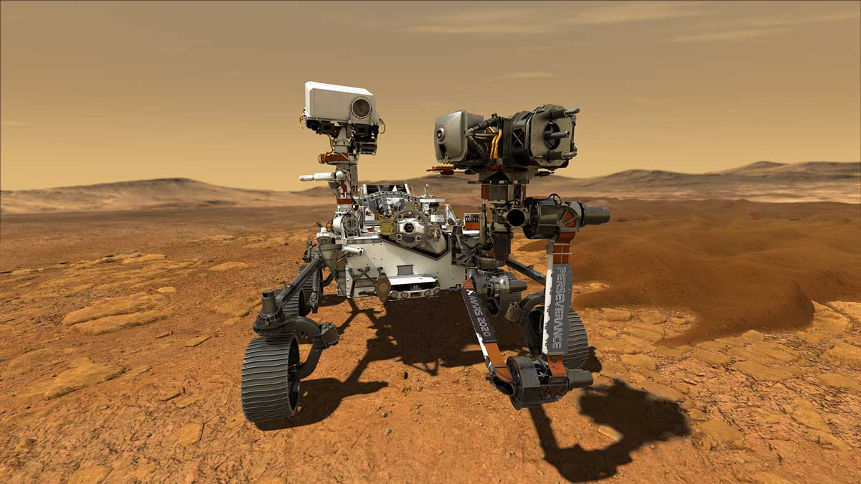
Example 2: Perseverance, 2020
Random forest for landmark registration!
Precision instrument targeting via image registration for the Mars 2020 rover. Doran et al, IJCAI 2016

Slide 41
Why?
?

Slide 42
Why?
Hardware constraints
Reliability
Interpretability
Easy to use

Slide 43
Step 6 – Host the model

Slide 44
Where models can live
Your machine
Cloud server
Mobile phone

Slide 45
Scenario 1
?
Learning about random forests with a Jupyter Notebook.
Where would the model live?

Slide 46
Scenario 1
Learning about random forests with a Jupyter Notebook.
Where would the model live?
On your own machine!

Slide 47
Scenario 2
?
Using simple linear regression in a mobile phone app
Where would the model live?

Slide 48
Scenario 2
Using simple linear regression in a mobile phone app
Where would the model live?
On the phone!

Slide 49
Scenario 3
?
Very deep neural net that uses a lot of memory and CPU to personalize website functions for users.
Where would the model live?

Slide 50
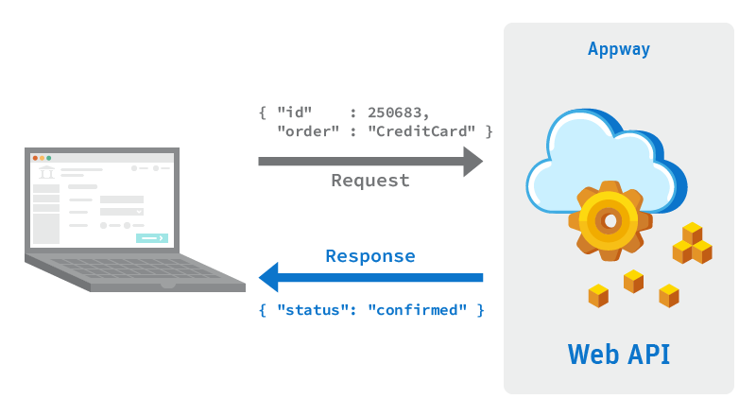
Scenario 3
Very deep neural net that uses a lot of memory and CPU to personalize website functions for users.
Where would the model live?
Dedicated host or cloud
A service!

Slide 51
Scenario 4
?
A model that updates book recommendations for users once a day.
Where would the model live?

Slide 52
Scenario 4
A model that updates book recommendations for users once a day.
Where would the model live?
Dedicated host or cloud

Slide 53
Step 7 - Monitoring and updating

Slide 54
A myth
?
“If we don’t do anything, model performance remains the same.”
Chip Huyen, Claypot AI

Slide 55
Data tends to drift
Seasonality
Change of habits
Unforeseen factors
Unexpected events
Can happen both in features and in labels!

Slide 56
Monitor for drifts
Distribution of feature values
Distribution of model predictions

Slide 57
Drift example
?

Slide 58
Drift example: COVID-19
Online shopping patterns changed – Stitch Fix
New terminology affected translation models – Facebook
Mobility patterns changed – Google

Slide 59

Business metrics too!
Model improvement ≠ business improvement
Model that improves clicks ≠ better conversion
150 successful machine learning models: 6 lessons learned at Booking.com. Bernardi et al, KDD 2019

Slide 60
When to update?
?

Slide 61
When to update?
?
To get started
When you feel the need (use metrics!)
On a set schedule, e.g. once a month
Eventually this can become automated
AWS and Netflix deploy multiple times a day

Slide 62
Other things to consider
Good software engineering practices
Fairness, law and ethics
Security
Quality assurance
User interface

Slide 63
A note on tools
Their name is Legion
Specific recommendations are impossible to give
Focus on the goal and architecture
Leverage available expertise

Slide 64
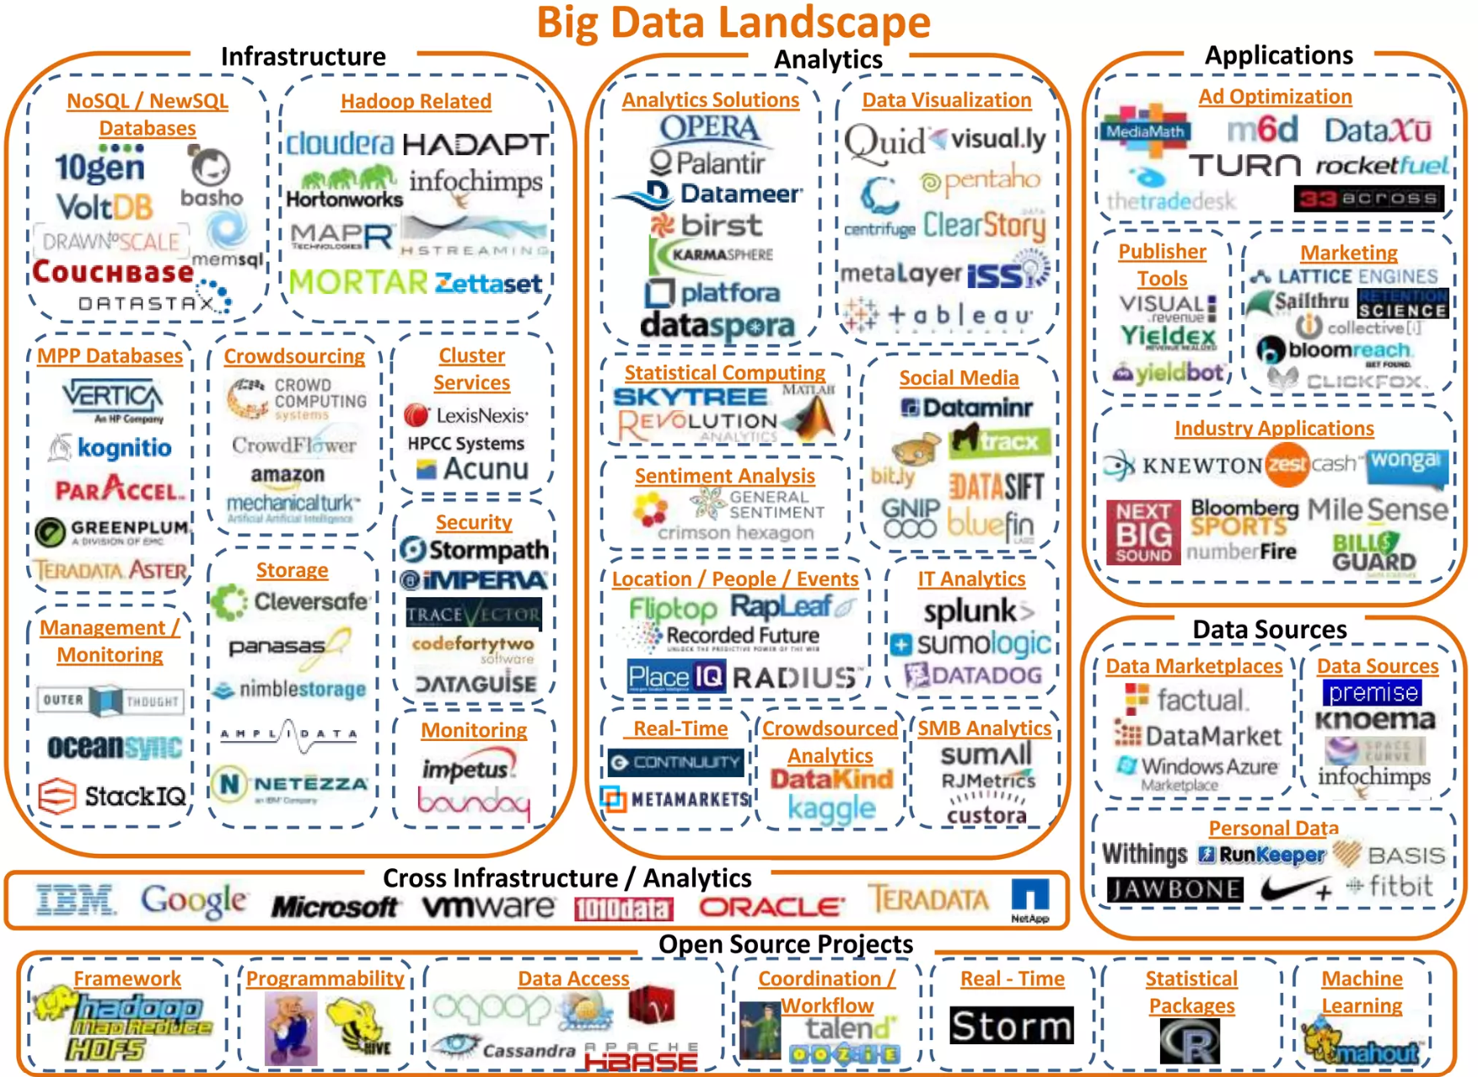

Slide 65
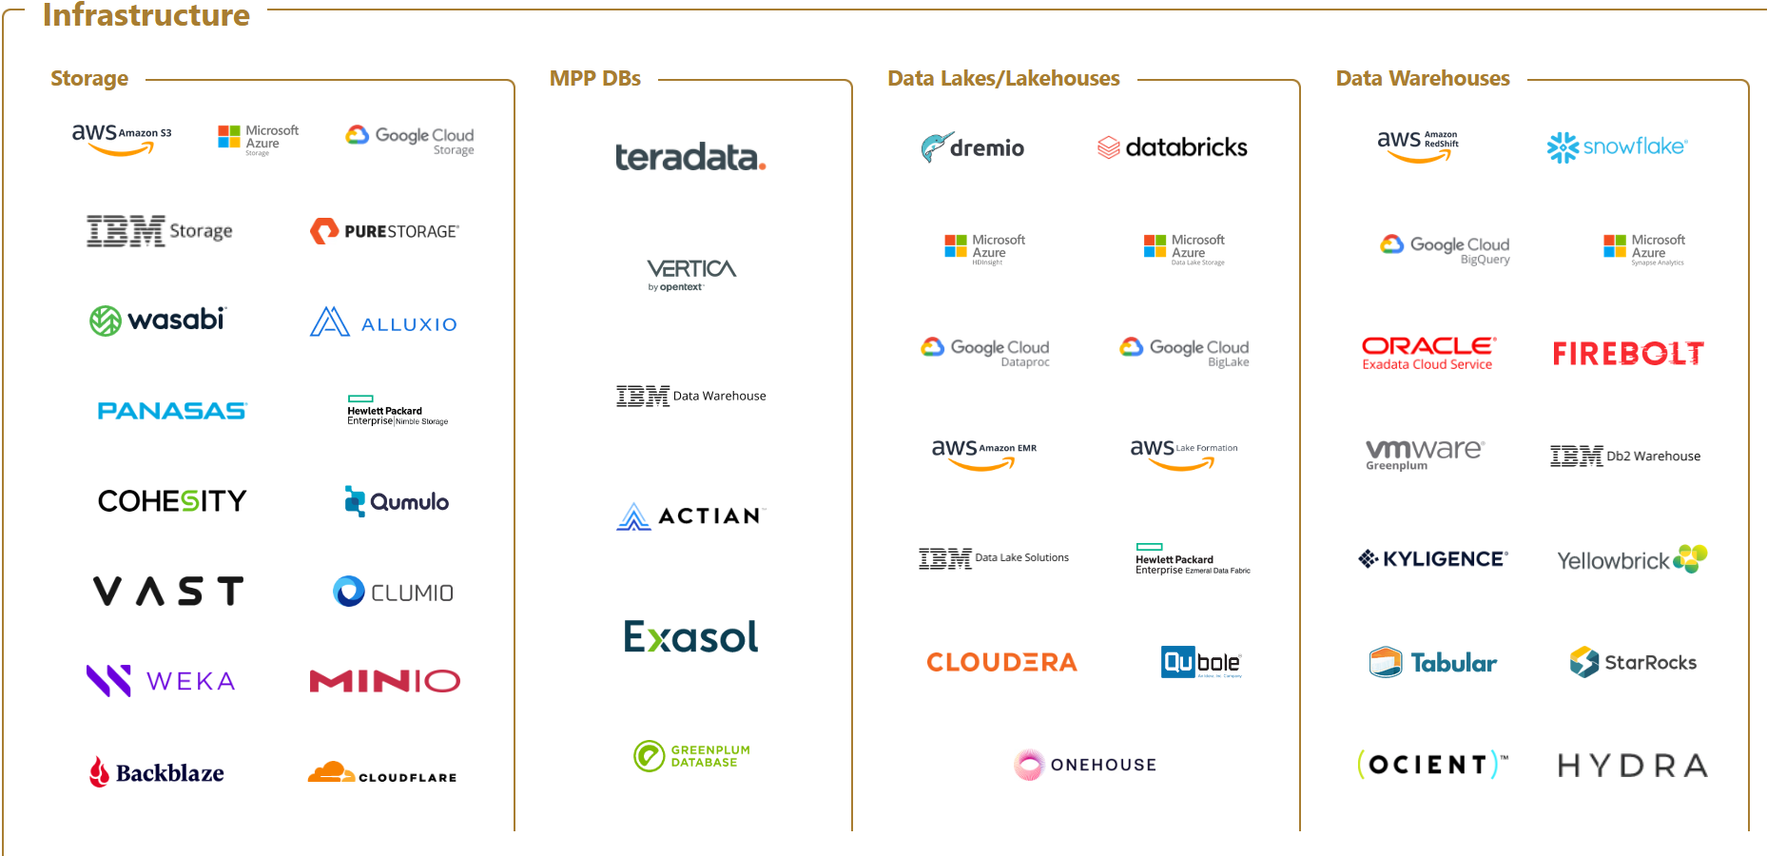

Slide 66
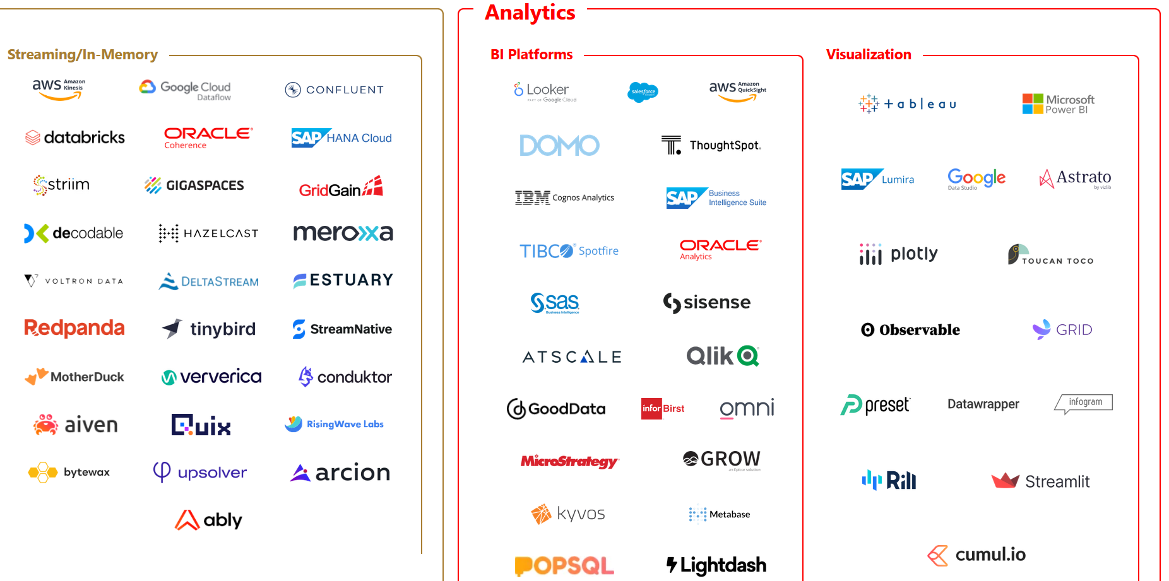

Slide 67
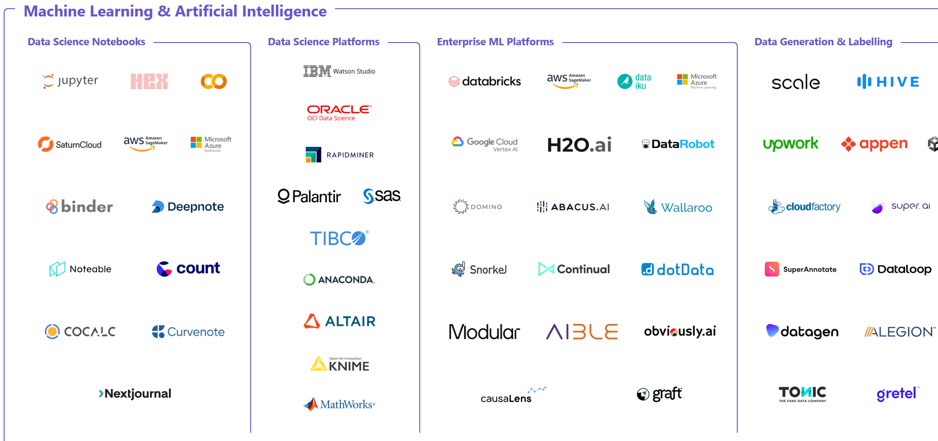

Slide 68
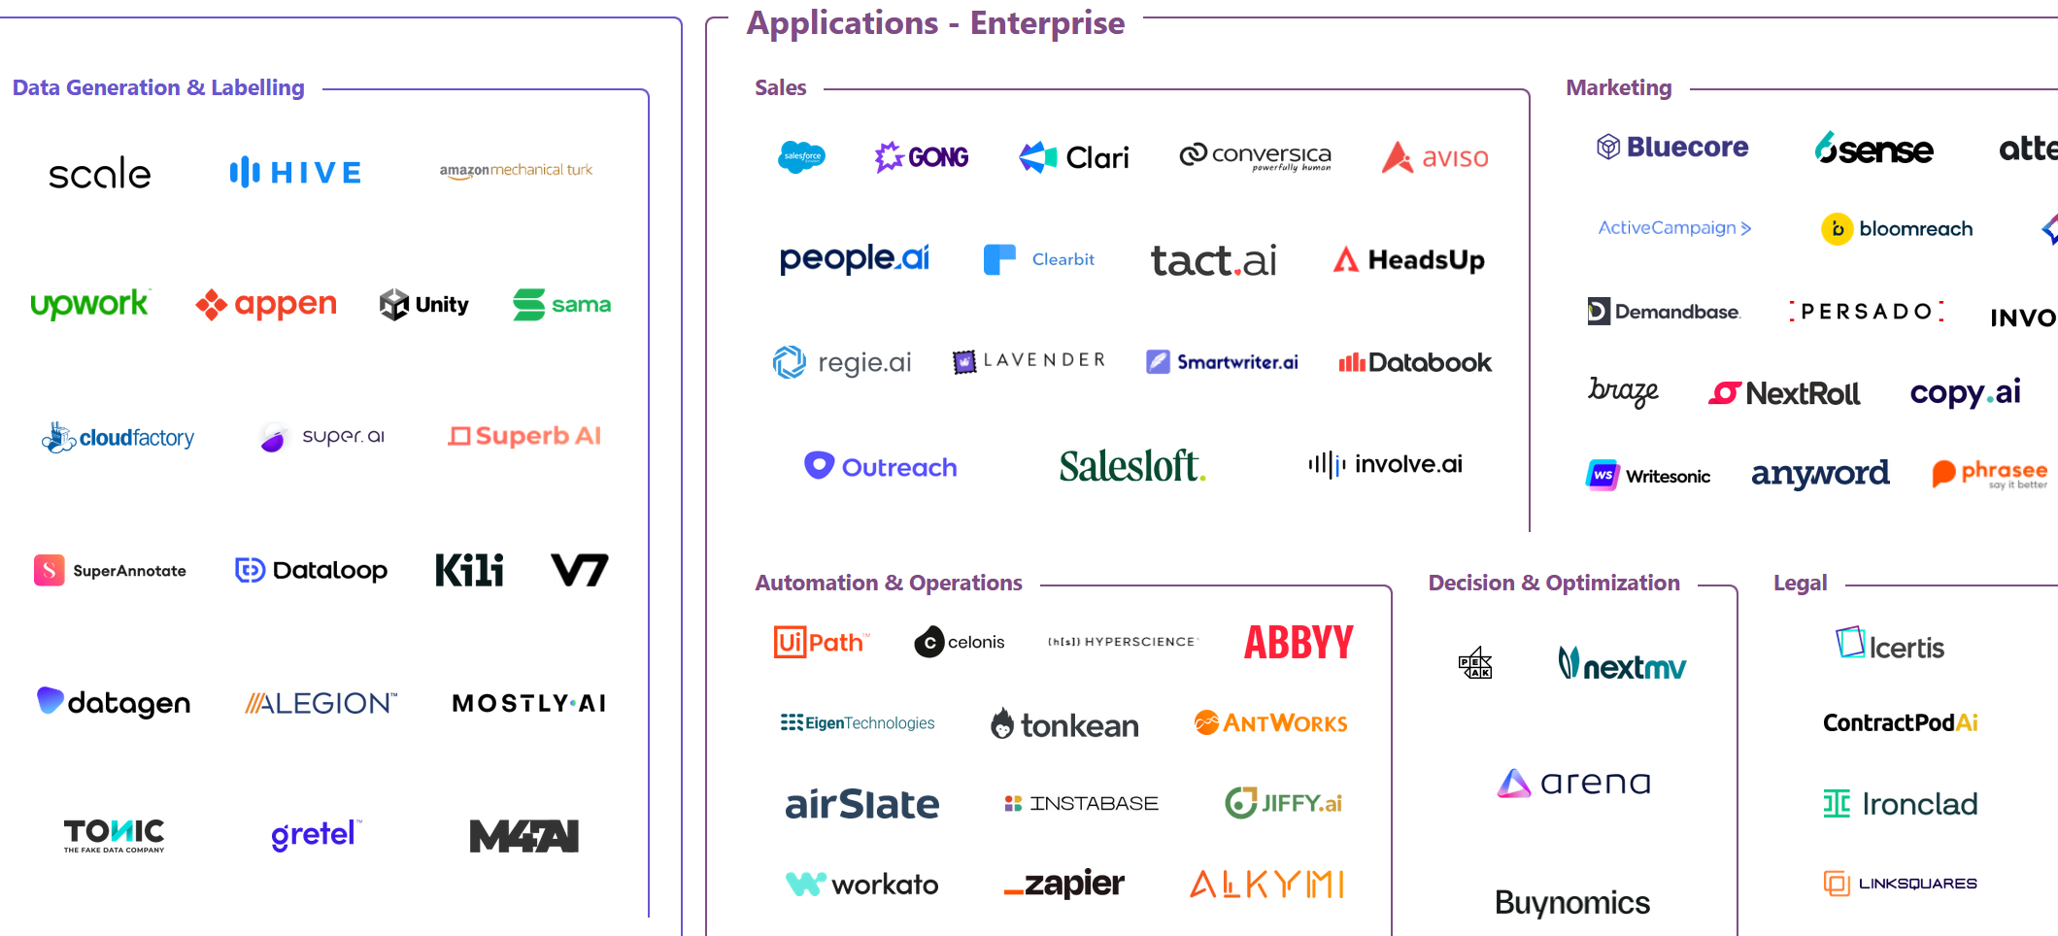

Slide 69
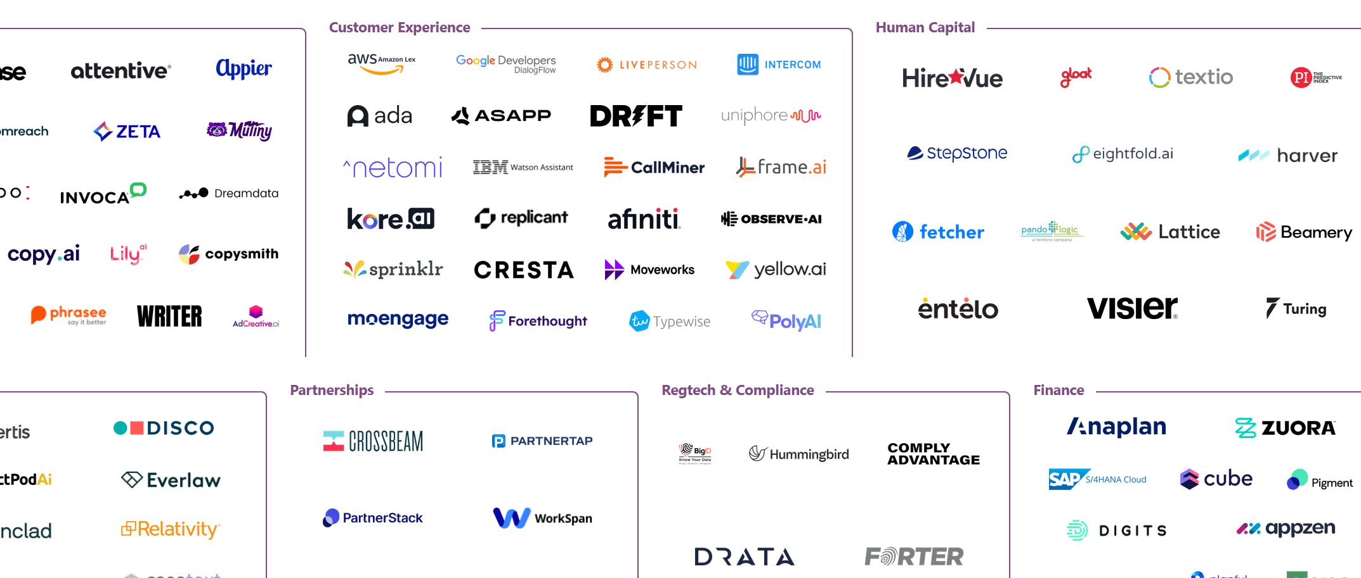

Slide 70
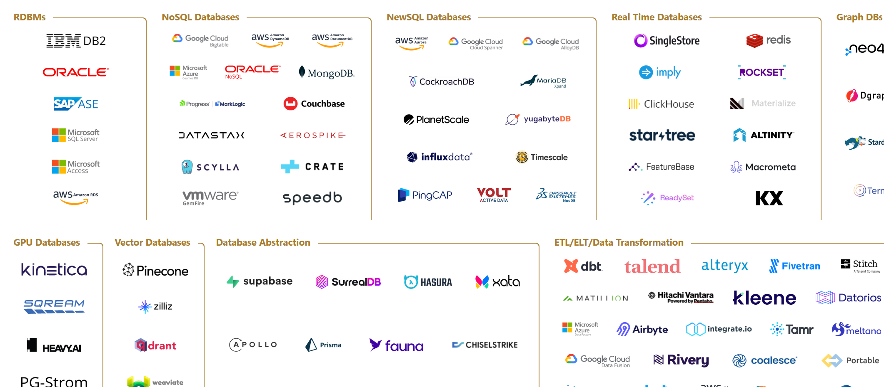

Slide 71
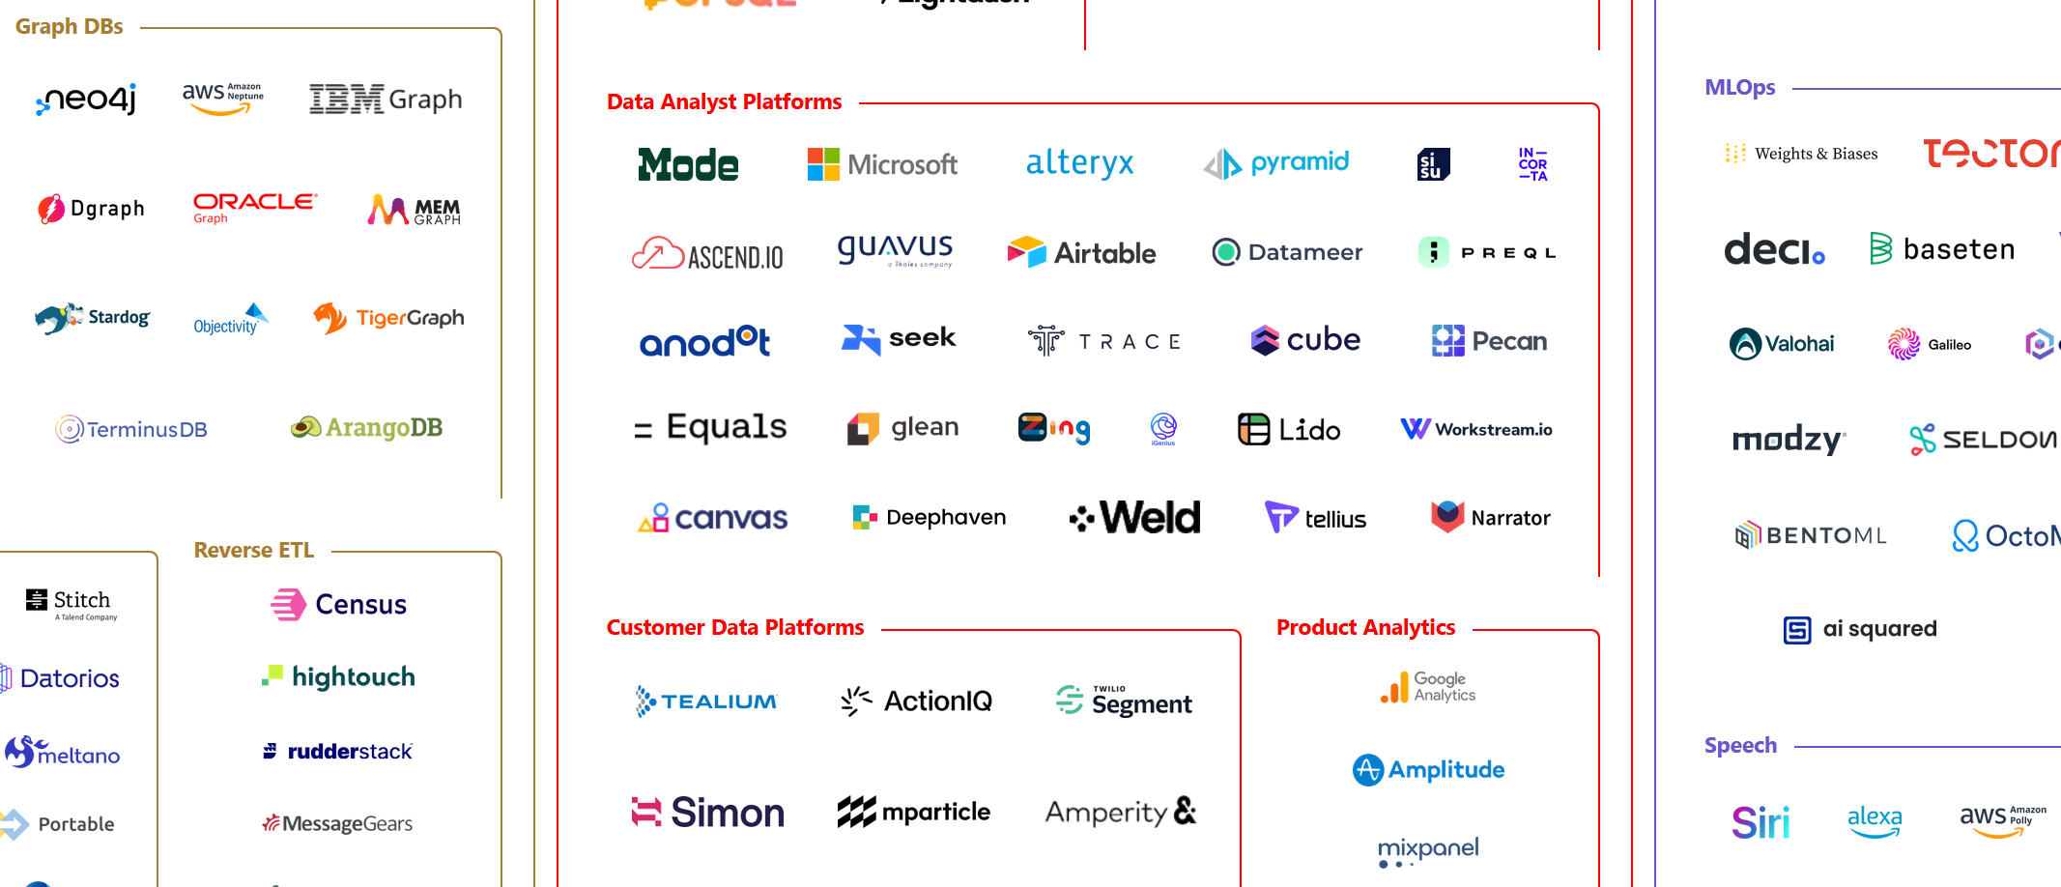

Slide 72
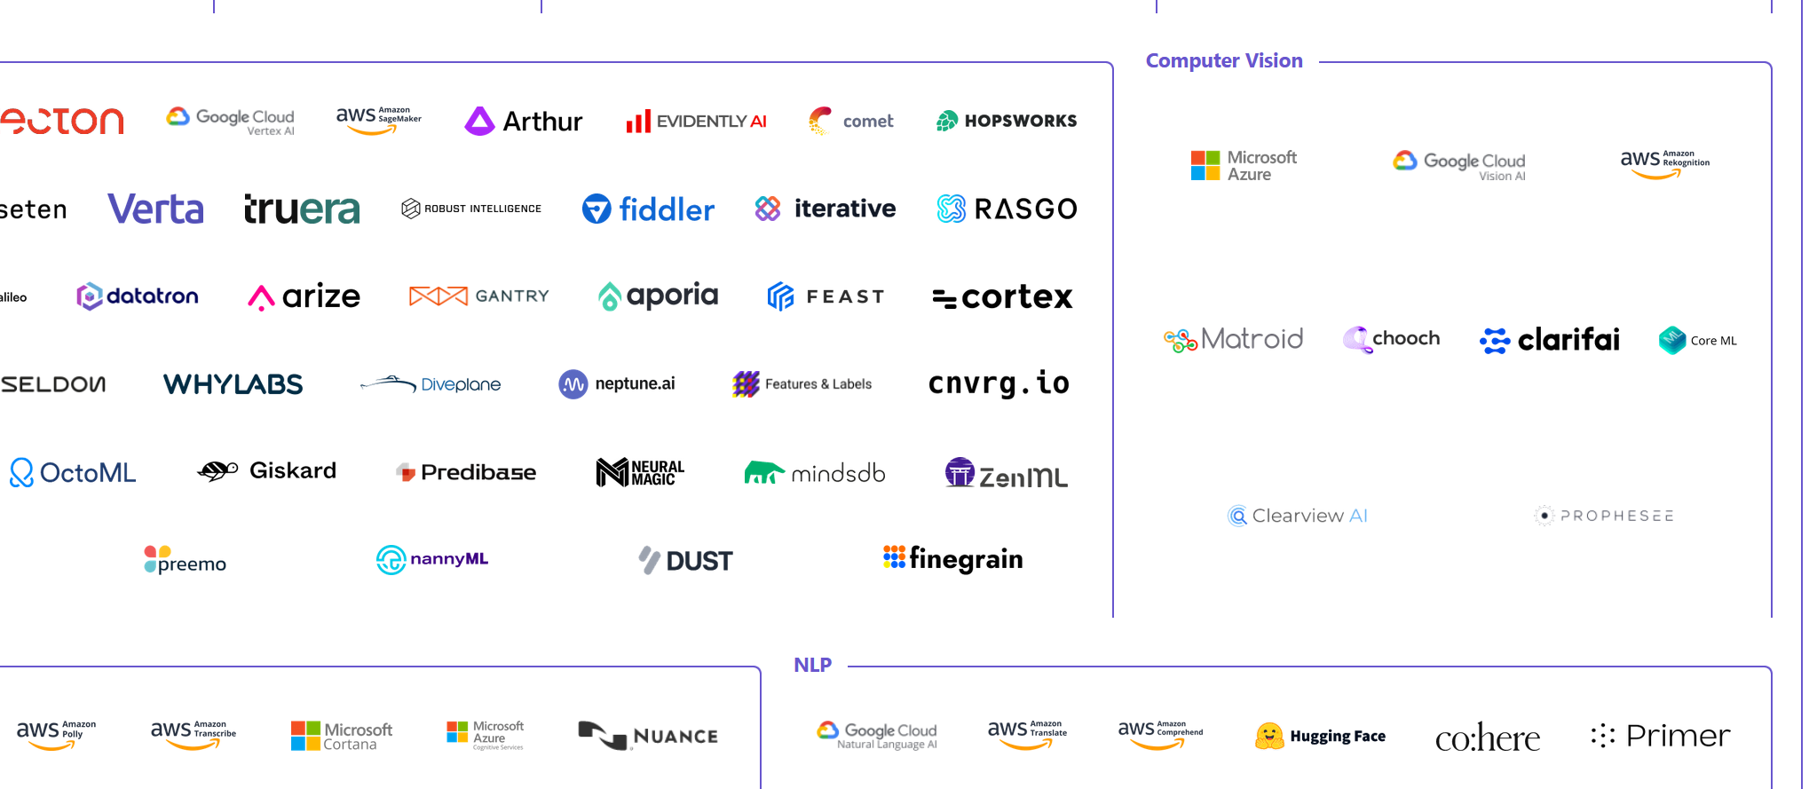

Slide 73
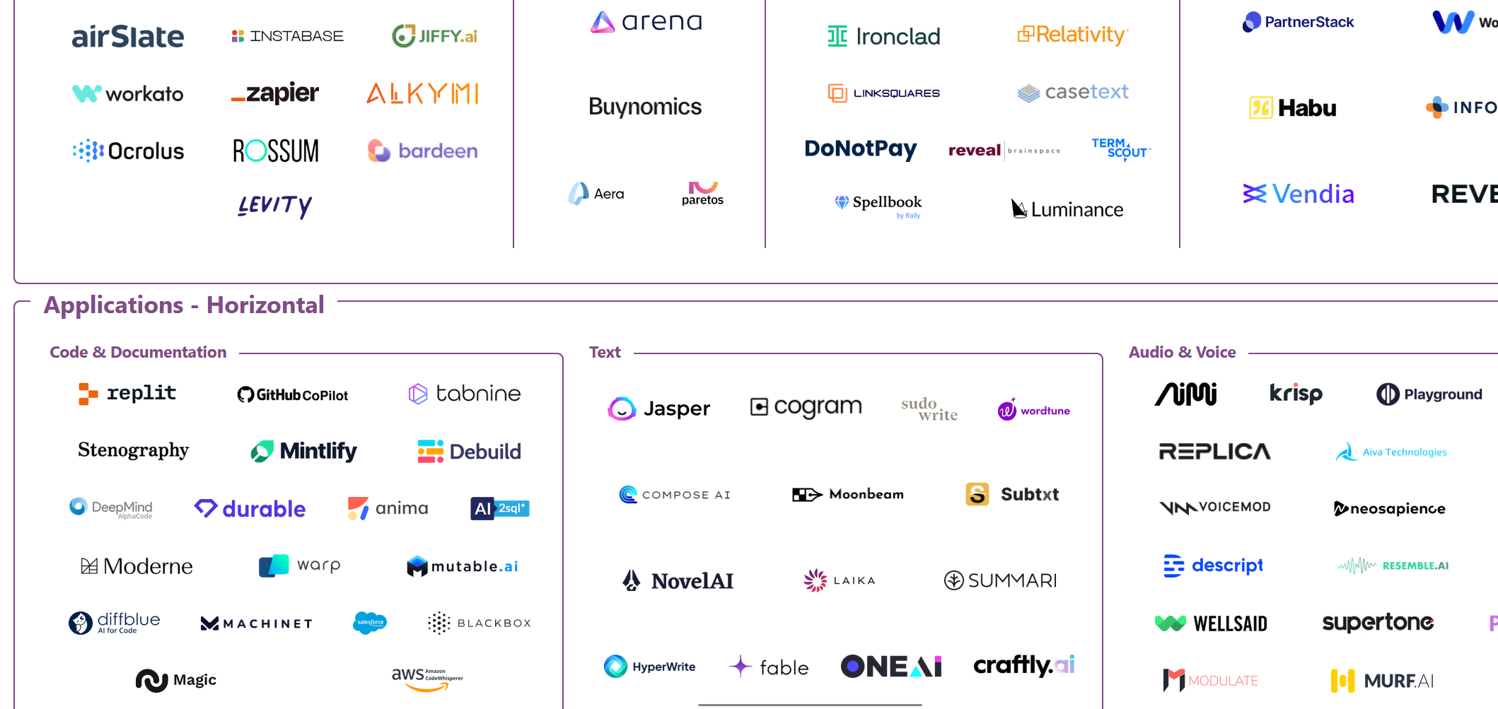

Slide 74
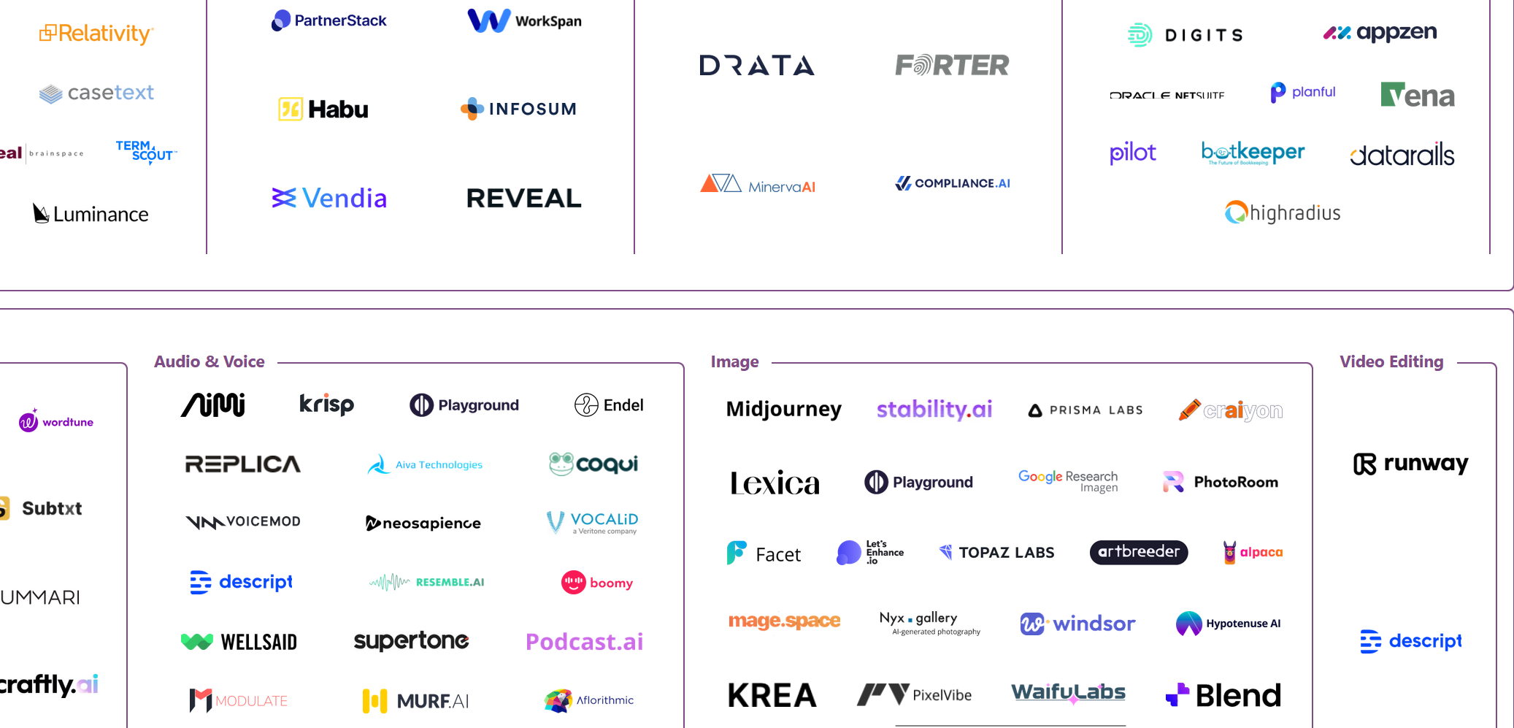

Slide 75
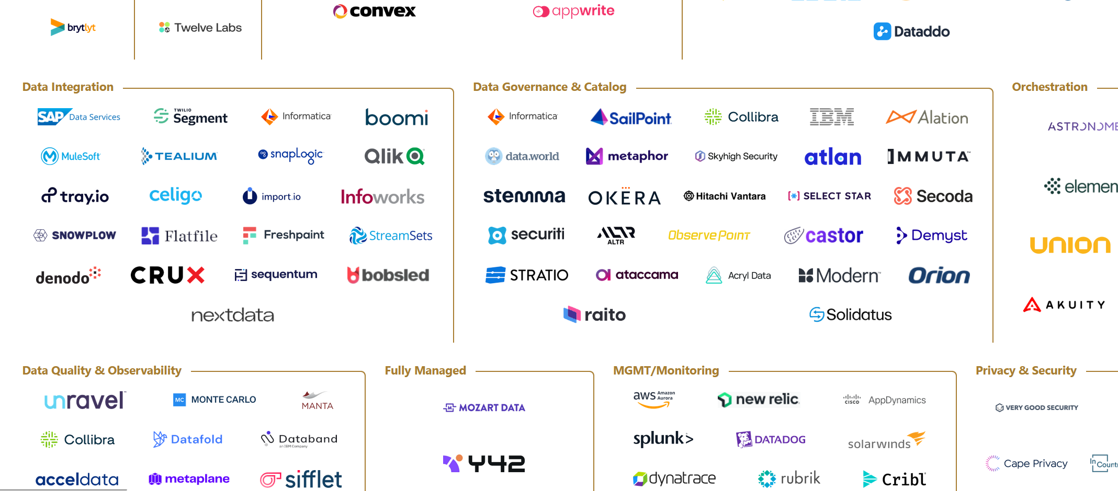

Slide 76
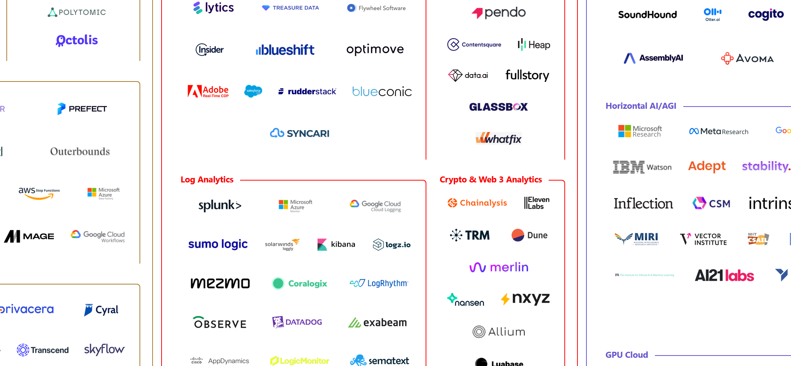

Slide 77
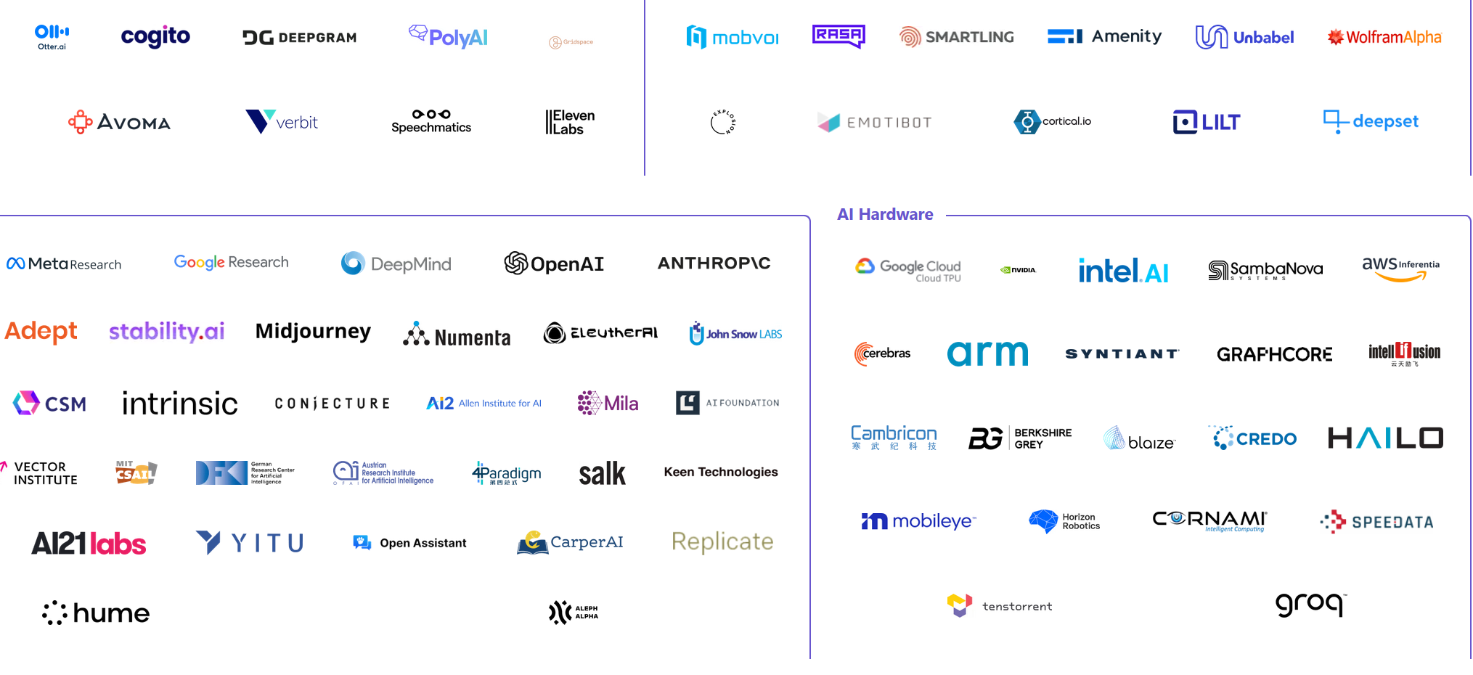

Slide 78
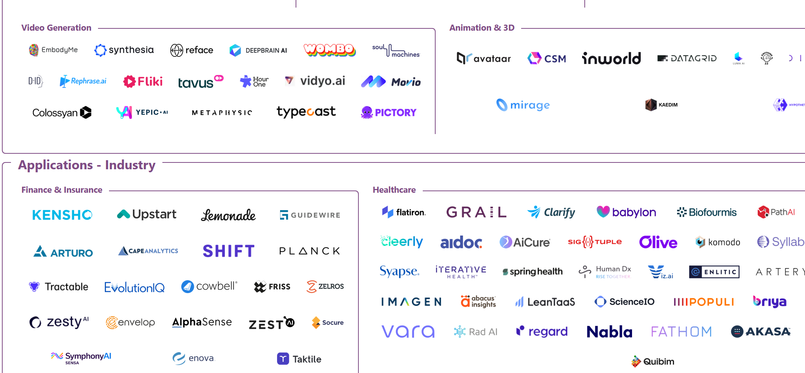

Slide 79
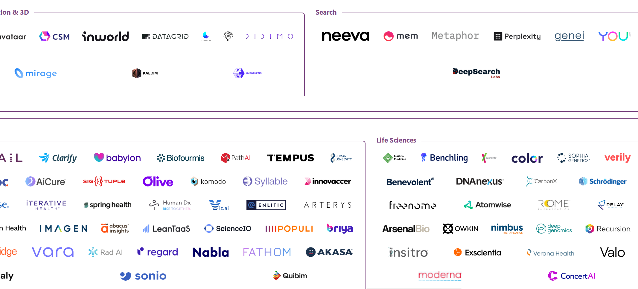

Slide 80
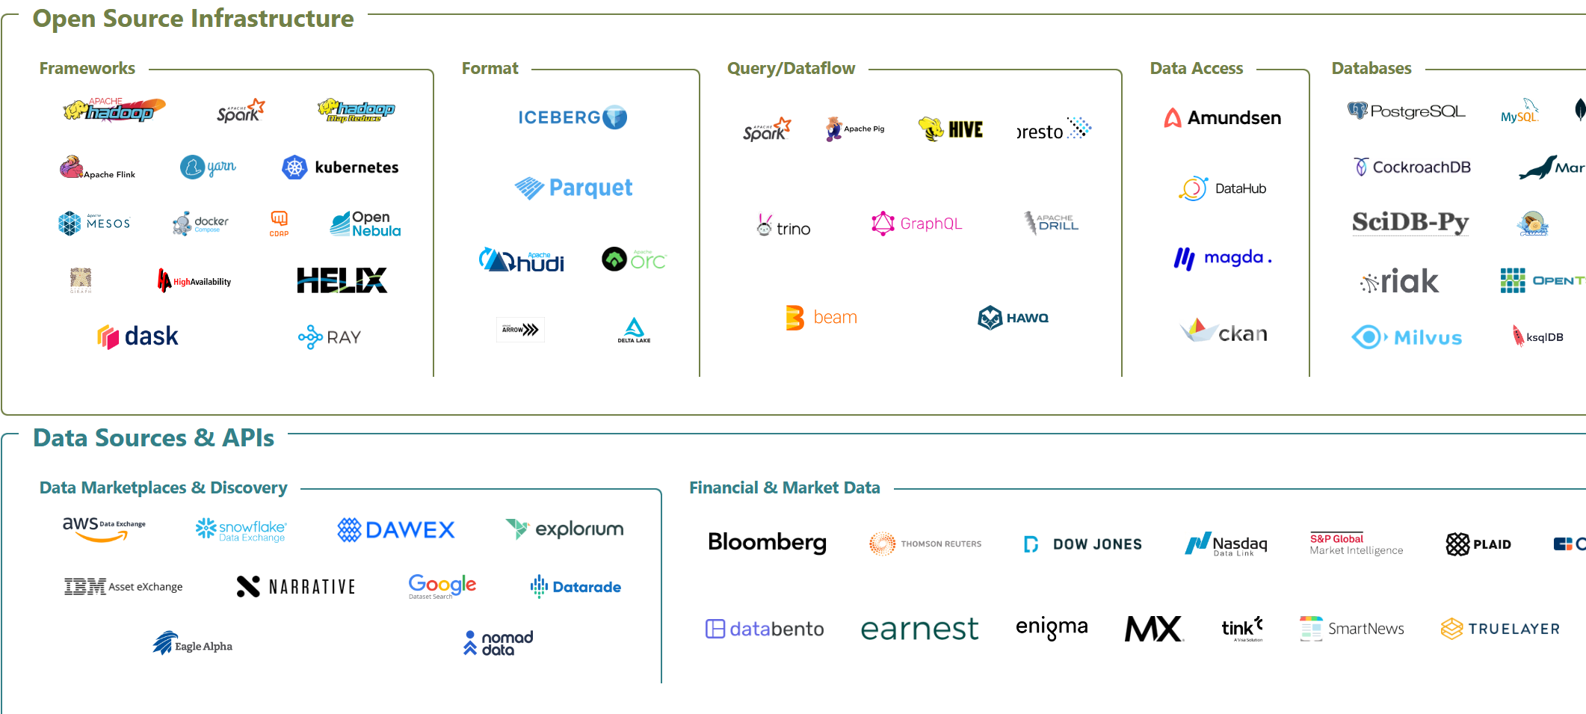

Slide 81
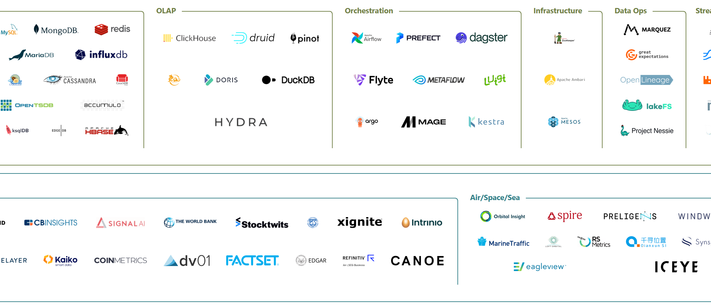

Slide 82
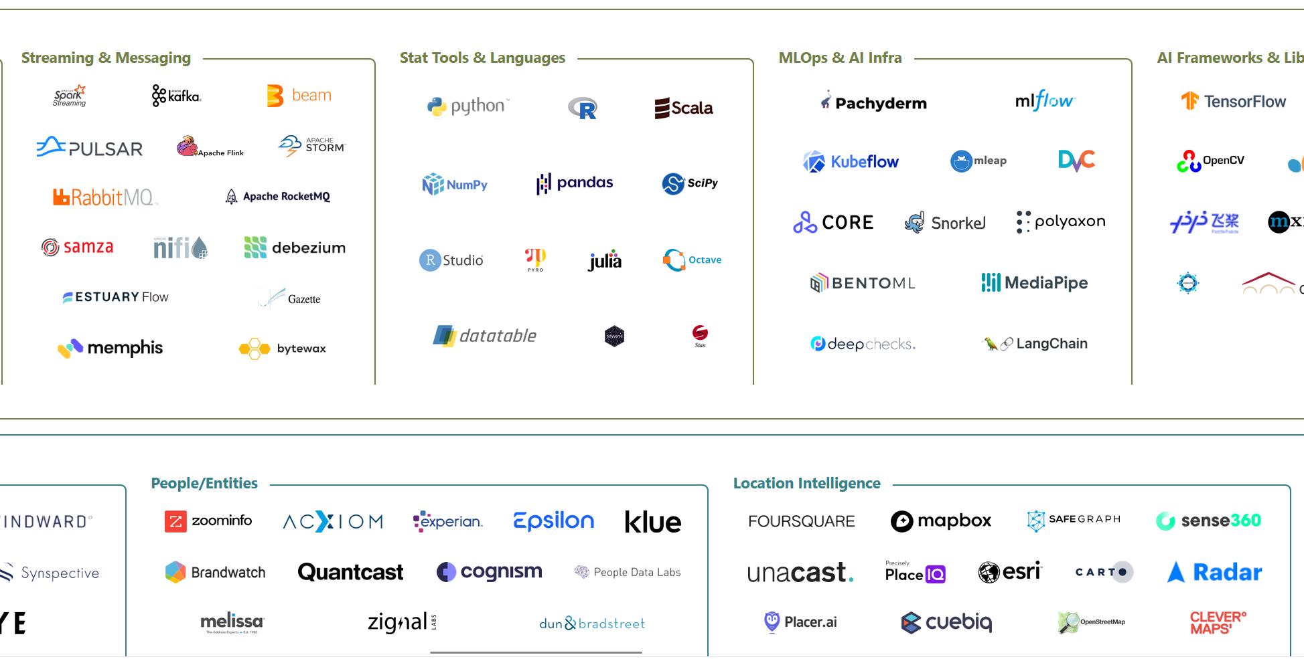

Slide 83
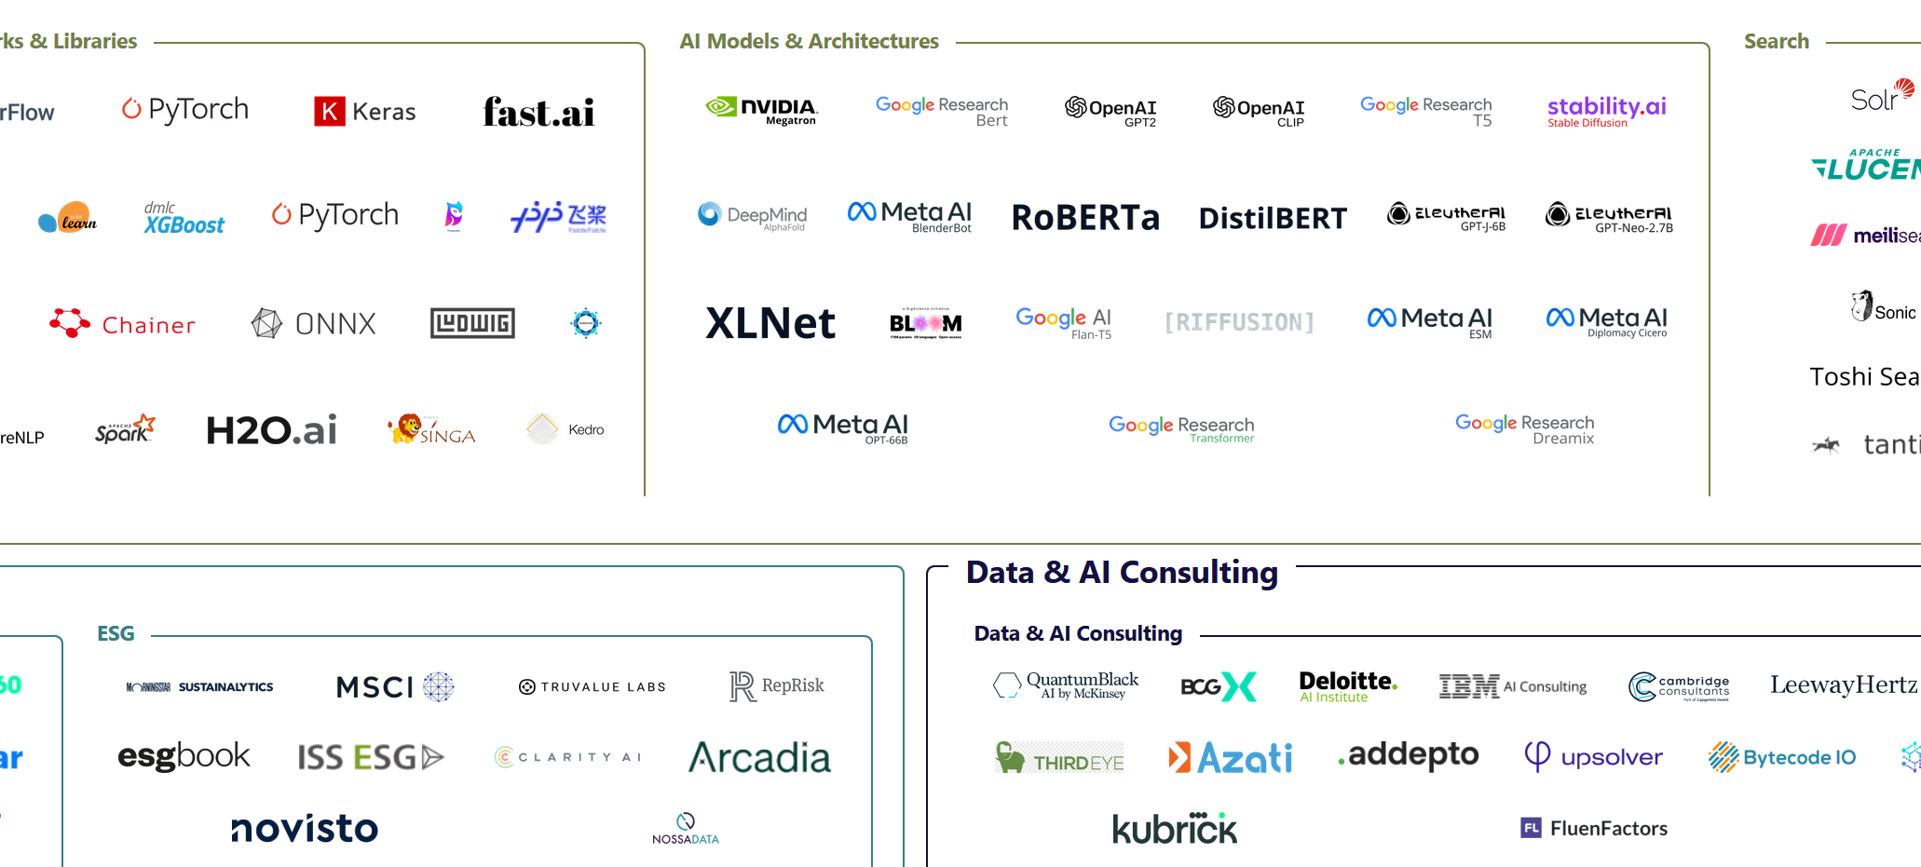

Slide 84
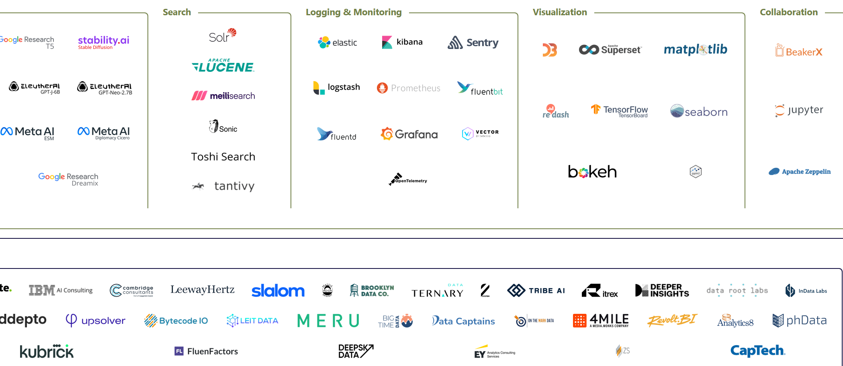

Slide 85
Where to go from here?
Learning by doing
Try doing something yourself

Slide 86
Where to go from here?
Good resources
Stanford MLSys Seminar series
https://mlsys.stanford.edu/
Chip Huyen’s blog and book
https://huyenchip.com/blog/
Rules of ML
https://developers.google.com/machine-learning/guides/rules-of-ml/
Coursera
https://www.coursera.org/specializations/machine-learning-engineering-for-production-mlops
ML@CL website
https://mlatcl.github.io/

Slide 87
Where to go from here?
Papers
Monitoring and explainability of models in production. Klaise et al., ICML DMML workshop 2020
Hidden Technical Debt in Machine Learning Systems. Sculley et al., NeurIPS 2015
Challenges in Deploying Machine Learning: a Survey of Case Studies. Paleyes et al, ACM Comp. Surv. 2022
Scaling Big Data Mining Infrastructure — The Twitter Experience. Lin and Ryaboy, KDD 2013
MLOps: A Taxonomy and a Methodology. Testi et al., IEEE Access 2022
150 successful machine learning models: 6 lessons learned at Booking.com. Bernardi et al, KDD 2019
Assuring the Machine Learning Lifecycle: Desiderata, Methods, and Challenges. Ashmore et al., ACM Comp. Surv. 2021
Software engineering for machine learning: A case study. Amerishi et al., ICSE 2019
Data lifecycle challenges in production machine learning: a survey. Polyzotis et al., ACM SIGMOD Record 2018

Slide 88
Summary
Sometimes ML is not needed
Get you success metric right
Getting data can be hard
So can be storing
Simple models often work best
Models live in different places
Monitor for drift in data and metrics
Also consider
Fairness, law and ethics
Privacy and security
Quality assurance
Good software engineering practices
User interface
Questions?

Slide 89
Appendix

Slide 90
Good software engineering practices
Version control is good (e.g. git)
Code reviews are good
Unit tests are good
Separation of concerns is good
Naming is important

Slide 91
Data ethics
Who owns the data?
How was it collected?
Do you have explicit permission to use the data?
Can you identify individuals from the dataset?
Can you use model trained on this dataset commercially?
Can you use privacy techniques?

Slide 92
Fairness
Can the training data contain biases?
Explicit biases
Hidden biases aka proxies
Are the classes balanced?
Is there a potential to aggravate bias?

Slide 93
Law
Is your area highly regulated?
Healthcare
Finance
Judicial
Will you operate somewhere with country-level laws?
EU – GDPR
Canada - PIPEDA
Kenya – Data Protection Act (similar laws exist in Uganda, Nigeria and South Africa)

Slide 94
Security
Data poisoning
Model reverse engineering aka model stealing
Model inversion

Slide 95
Quality assurance
Do you have acceptance criteria for the system?
How does model performance translate to business value?
Can you test model in real life, e.g. with A/B test?
If not, maybe you can use a simulation?

Slide 96
User interface
Good UX increases trust
Bad UX limits adoption
ML terms are not easy to understand
Focus on what user wants to see, not on ML

